Slide 1
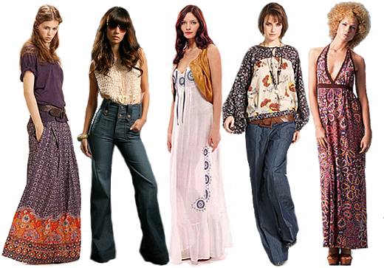
IN THE 70s

Slide 2
On the left hand side, the girl is wearing a loose flowery skirt ,a purple wide tee-shirt

Slide 3
On the left centre , the girl is wearing a funky tank top and bell bottoms jeans . She is wearing a sun glasses

Slide 4
In the centre, the girl is wearing a tight jaket and a loose formal dress but I can’t see her shoes

Slide 5
In the middle right, the girl is wearing a wide flowery blouse and regular blue jeans

Slide 6
On the right hand side, the woman has an afro hair style. She is wearing a long flowery dress.

Slide 7
The women 1,4 and 5 are wearing more flowery clothes than the women 2 and 3.

Slide 8
The end
Work by engin Kilic and Tom Audaire

